Slide 1
PROFESSOR VELAZQUEZ
INTRODUCTION
TO
MICROECONOMICS
MODULE 06 · MARKETS, HISTORY AND THE GLOBAL ECONOMY
FALL 2025

Slide 2
06
Markets, History &
the Global Economy
The bridge module. You have now built the complete neoclassical toolkit. This module lays the whole history of human economic life beside it and asks: what does the toolkit explain — and what does it struggle to explain?
MODULE

Slide 3
MODULE 6 · BRIDGE MODULE
Agenda, Big Questions & Do Now
BIG QUESTIONS
PRE-WORK
WHAT YOU'LL NEED
(1) Why did global living standards remain stagnant for ten thousand years and then explode in the last 200 — and why did this explosion happen UNEVENLY?
(2) What are the three engines of long-run economic growth — and how does each generate the others?
(3) When markets generate negative externalities, what tool do economists reach for — and is it sufficient?
· Review your notes and worksheets from Modules 1–5 — this module is a synthesis and assumes all of them
· Complete the Module 6 Vocabulary Checklist
· Bring the Module 6 Worksheet
· Optional: Acemoglu & Robinson, Why Nations Fail, Ch. 1–2
· Module 6 Worksheet (printed)
· All five previous worksheets — Part 1 is a synthesis map across them
· Pencil and graph paper for the externality diagram in Part 6
DO NOW · OPENING INQUIRY
You have now built the complete neoclassical toolkit: choice, constraint, supply, demand, elasticity, efficiency, factor markets. This module asks a harder question — when the full history of human economic life is laid out before us, WHAT DOES OUR TOOLKIT EXPLAIN, AND WHAT DOES IT STRUGGLE TO EXPLAIN?
AGENDA — DAY 1 · GROWTH | TIME | AGENDA — DAY 2 · DIVERGENCE & LIMITS | TIME
Do Now + Part 1: toolkit synthesis and the course thesis | 25 min | Part 4 — The Great Divergence and four competing hypotheses | 30 min
Part 2 — The Malthusian trap and the demographic transition | 25 min | Part 5 — Poverty measurement and the Kuznets Curve | 20 min
Part 3 — Three engines of growth and the hockey stick | 25 min | Part 6 — Climate Arc Part 1: market failure and externalities | 25 min
INTRO TO MICROECONOMICS | PROF. VELAZQUEZ
MODULE 6: MARKETS, HISTORY & THE GLOBAL ECONOMY

Slide 4
BEFORE WE BEGIN
Vocabulary Checklist — Module 6
Synthesis Toolkit
Course Thesis (emerging)
Markets as Social Institutions
Three Engines of Growth
Labor Productivity
Capital Deepening
Technological Change
Total Factor Productivity (A)
Solow Residual
Hockey Stick
Great Divergence
Malthusian Trap
Demographic Transition
Inclusive vs. Extractive Institutions
Path Dependence
Absolute Poverty
Relative Poverty
Poverty Trap
Kuznets Curve
Purchasing Power Parity (PPP)
Climate Arc — Part 1
Market Failure
Negative Externality
Private vs. Social Cost
Tragedy of the Commons
WHAT MAKES THIS MODULE DIFFERENT
Modules 1–5 taught you HOW TO USE the tools. Module 6 asks WHAT THE TOOLS ARE FOR, and where they stop working. There is less new machinery here and more argument — which is exactly what the second half of the course will demand of you.
INTRO TO MICROECONOMICS | PROF. VELAZQUEZ
MODULE 6: MARKETS, HISTORY & THE GLOBAL ECONOMY

Slide 5
01
Toolkit Synthesis —
Connecting Modules 1–5
PART
OBJECTIVE Synthesize the tools from Modules 1–5; articulate the emerging course thesis about markets and their limits.
INTRO TO MICROECONOMICS | PROF. VELAZQUEZ
MODULE 6: MARKETS, HISTORY & THE GLOBAL ECONOMY

Slide 6
PART 1 · THE SYNTHESIS MAP
Five Modules, Six Tools, Six Limitations
ANALYTICAL TOOL | M | CORE QUESTION IT ANSWERS | KEY LIMITATION
Budget Constraint / Production Possibilities Model | 1 | What combinations are FEASIBLE given income, resources and technology? What is the opportunity cost of moving between them? | Says nothing about which feasible point is CHOSEN, nor about who was handed which constraint in the first place.
Indifference Curves / Optimal Bundle | 2 | Given a feasible set, WHICH point does an agent choose? Optimization where MRS = Px/Py. | Assumes stable, consistent, fully-informed preferences. Behavioral economics (M2 Part 4, M12) shows systematic violations.
Supply & Demand / Equilibrium | 3 | How does a decentralized price coordinate millions of strangers without a planner? Where does the market clear? | Clearing is not the same as fairness. Willingness to pay is limited by ABILITY to pay, so need does not appear in demand.
Elasticity | 4 | HOW MUCH do quantities respond to a price change? Who is sensitive and who is captive? | Measures responsiveness, not its cause. Low elasticity from genuine preference and low elasticity from constraint look identical.
Consumer & Producer Surplus / Deadweight Loss | 4 | Is this outcome EFFICIENT? How much total gain from trade does the market generate, and how much does an intervention destroy? | Total surplus is measured in dollars and counts every dollar equally, whoever holds it. It also omits everyone outside the transaction.
VMP / Factor Markets | 5 | What determines wages, rents and interest rates? Is a factor paid what it contributes? | The prediction W = VMP requires perfect competition. Market power, discrimination and institutional constraint each break it.
NOTICE THE PATTERN IN THE RIGHT-HAND COLUMN
Every tool is powerful and every limitation is the same limitation, restated: THE MODEL TAKES THE CONSTRAINTS AND THE DISTRIBUTION AS GIVEN. It explains behavior WITHIN a structure and is silent about who built the structure. That is the hinge on which the second half of this course turns.
WHAT IT DOES BRILLIANTLY
WHAT IT CANNOT DO ALONE
WHY BOTH MATTER
Predicts the DIRECTION and MAGNITUDE of response to any price or quantity change.
Tell you whether the resulting distribution is defensible, or who wrote the rules.
A critique that cannot use the model is as weak as a model that refuses critique.
INTRO TO MICROECONOMICS | PROF. VELAZQUEZ
MODULE 6: MARKETS, HISTORY & THE GLOBAL ECONOMY

Slide 7
PART 1 · THE EMERGING THESIS
Markets as Social Institutions
"Markets are powerful institutions for COORDINATION AND ALLOCATION,
but they systematically fail when COSTS AND BENEFITS FALL ON PEOPLE
WHO ARE NOT PARTY TO THE TRANSACTION — and they are silent about DISTRIBUTION."
This is a draft. Write your own version on the worksheet, and revise it after every remaining module.
1
MARKETS ARE NOT NATURAL OBJECTS
2
WHICH MEANS THE RULES ARE A CHOICE
3
AND THE RULES PERSIST
A market requires property rights, contract enforcement, weights and measures, courts, and a shared understanding of what may be bought and sold. Every one of those is a SOCIAL INSTITUTION, designed and maintained by people.
There is no 'free' market in the sense of a market without rules. There are only different rules.
Athenian agora, Roman property law, Han standardized weights, the Abbasid hawala credit network — each lowered transaction costs and widened participation.
The Inca mit'a, Aztec tribute, the Mesopotamian temple grain monopoly, Roman latifundia — each concentrated surplus in an elite. Same economics, opposite institutions.
Acemoglu & Robinson (2012, Nobel 2024): the single biggest predictor of long-run growth is INSTITUTION TYPE — inclusive or extractive.
Dell (2010): districts just inside the Spanish colonial mit'a boundary have consumption 25% LOWER today than districts just outside — five hundred years later. Institutions have MEMORY.
✦1 THE ONE ASSUMPTION
Looking across Modules 1–5, identify the assumption you believe is most consequential for the conclusions economists draw. Strong candidates: perfect competition (broken in M10–11), complete and symmetric information (broken in M12), no externalities (broken TODAY in Part 6), stable rational preferences (broken in M2 and M12), and the treatment of the initial distribution of endowments as exogenous (broken in M7). Name which module you expect to challenge it most directly.
INTRO TO MICROECONOMICS | PROF. VELAZQUEZ
MODULE 6: MARKETS, HISTORY & THE GLOBAL ECONOMY

Slide 8
02
The Malthusian Trap
& the Demographic Transition
PART
OBJECTIVE Apply the Malthusian trap and the demographic transition; evaluate Malthus's prediction and identify the escape mechanism.
INTRO TO MICROECONOMICS | PROF. VELAZQUEZ
MODULE 6: MARKETS, HISTORY & THE GLOBAL ECONOMY

Slide 9
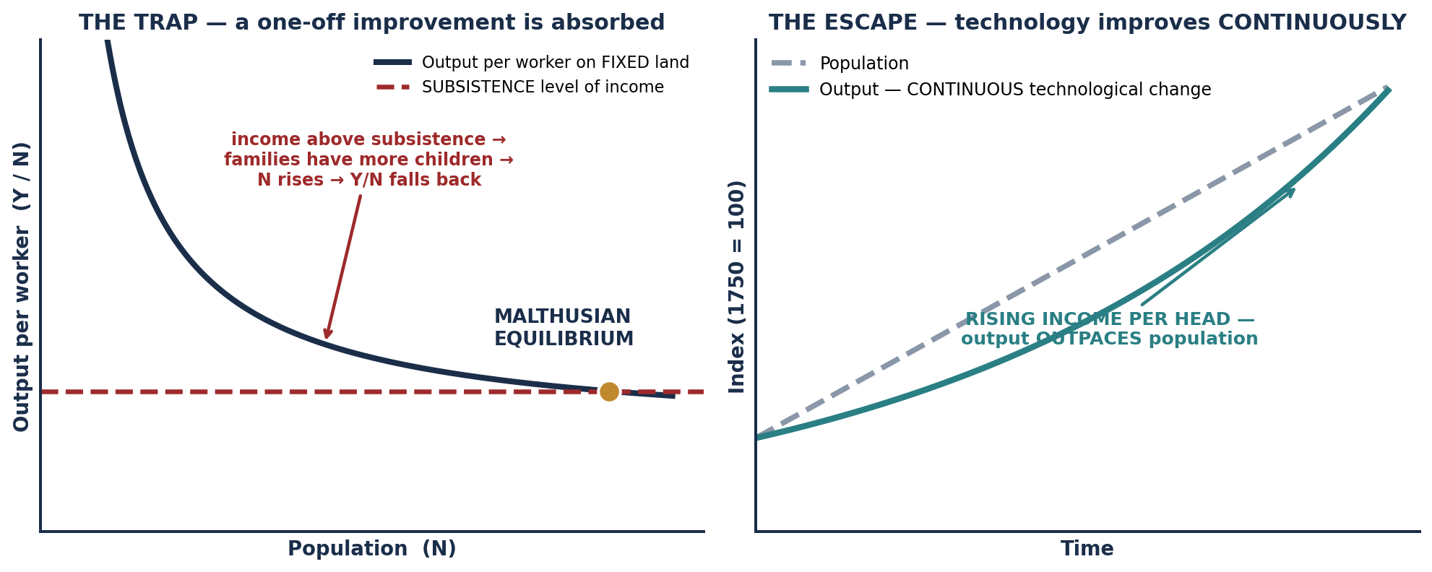
PART 2 · OPTIMIZATION UNDER A HARD CONSTRAINT
Malthus' Model — Optimization at the Population Level
WHAT IS A CONSTRAINT?
THE KEY IDEA
MALTHUS' TWO INPUTS
Any limit on what a person, firm or society can achieve:
· RESOURCE constraints — limited land, labor or capital
· KNOWLEDGE constraints — technology not yet invented
· INSTITUTIONAL constraints — laws, property rights, social rules
People do not make 'bad' choices irrationally. They OPTIMIZE WITHIN THE CONSTRAINTS THEY FACE.
Understanding historical behavior therefore means asking: what were the constraints? What were the available options?
Only LAND (fixed) and LABOR (variable).
As more workers farm the same land, output per person FALLS — the law of diminishing average product, which you met as diminishing marginal product in Module 2.
THE TRAP, IN FOUR STEPS
(1) LAND IS FIXED, so output per head falls as population rises. (2) When living standards rise above subsistence, individual families rationally choose to HAVE MORE CHILDREN — more labor, more security, more care in old age. (3) Each family's rational optimization RAISES total population, which LOWERS wages for everyone. (4) Living standards settle back at SUBSISTENCE. Any improvement is temporary.
INTRO TO MICROECONOMICS | PROF. VELAZQUEZ
MODULE 6: MARKETS, HISTORY & THE GLOBAL ECONOMY

Slide 10
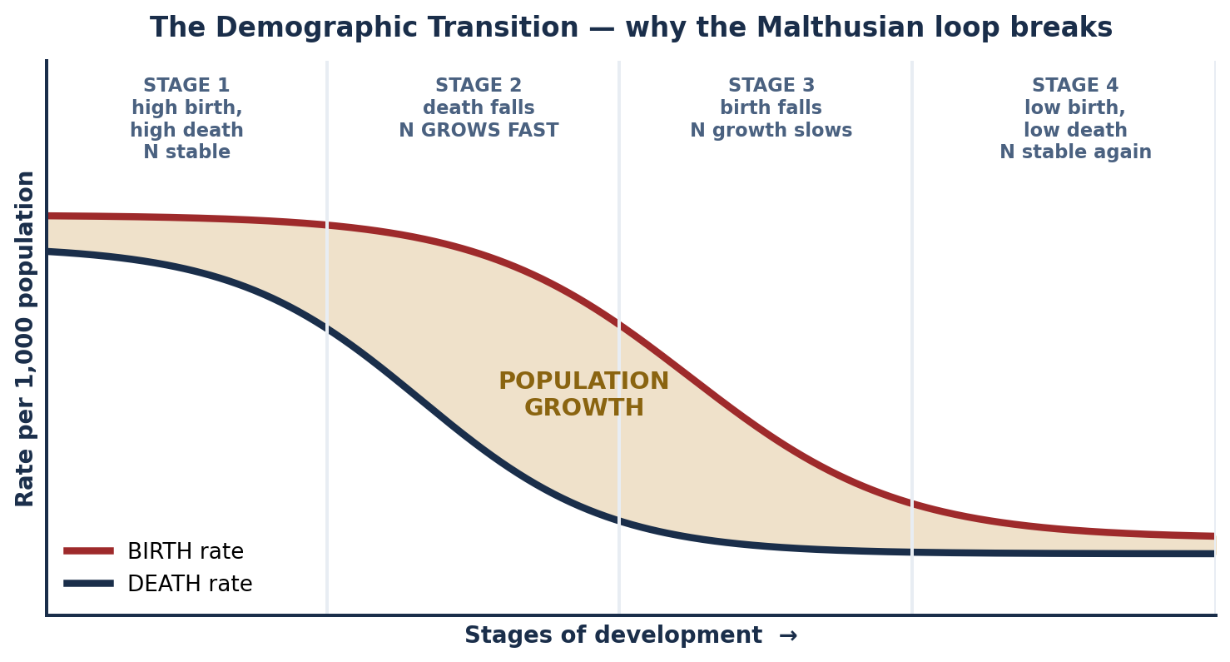
SCENARIO 6.1 · ENGLAND C. 1800 & SUB-SAHARAN AFRICA C. 1960–90
Was Malthus Right? — The Escape and the Transition
MALTHUS WAS RIGHT ABOUT…
ONE-OFF improvements. A single better harvest → population grows → income returns to subsistence. Within a world of episodic, non-cumulative technical change, his model is correct — and it accurately describes roughly ten thousand years of human history.
MALTHUS WAS WRONG BECAUSE…
Technology did not improve ONCE — it improved CONTINUOUSLY.
KEY MECHANISM: each innovation created new problems requiring new solutions, and the pace of change ACCELERATED rather than stabilizing.
THE ESCAPE: when technology improves continuously and fast enough, output per worker OUTPACES population growth. The fixed-land constraint is effectively RELAXED by technology — better seeds, machinery, chemicals. In our vocabulary: the production possibilities frontier EXPANDS rather than staying fixed.
THE DEMOGRAPHIC TRANSITION
The second half of the escape. As incomes rise, FERTILITY RATES FALL — breaking the Malthusian loop at its own hinge.
Why: child mortality falls so fewer births are needed; children shift from farm labor (an asset) to schooling (a cost); women's opportunity cost of time rises; contraception and family planning become available. The rational family response to higher income becomes FEWER, MORE-INVESTED-IN children rather than more children.
APPLYING IT TO MARCUS
In a low-income neighborhood with constrained access to family planning, education and health care, the Malthusian logic predicts a HIGHER-FERTILITY, LOWER-INVESTMENT equilibrium — not because of preference, but because the transition's PRECONDITIONS are absent. The constraint, again, is institutional.
INTRO TO MICROECONOMICS | PROF. VELAZQUEZ
MODULE 6: MARKETS, HISTORY & THE GLOBAL ECONOMY

Slide 11
PART 2 · WORKSHEET ✦2
When Does the Malthusian Trap Still Bind?
THE QUESTION
Malthus wrote in 1798 and was spectacularly wrong about Britain — yet elements of his model remain relevant for some economies today. Under what conditions does the Malthusian trap bind, and what specific institutional or technological changes allow societies to escape it?
1
WHEN IT BINDS
2
WHAT ENABLES ESCAPE
3
THE CAUTION
· When technological change is EPISODIC rather than cumulative — a one-off gain gets absorbed.
· When the binding factor is genuinely FIXED and not augmentable (arable land, fresh water, fisheries).
· When the DEMOGRAPHIC TRANSITION has not begun, because its preconditions — falling child mortality, schooling, women's education — are absent.
· When institutions prevent the SURPLUS from being reinvested in productivity.
TECHNOLOGICAL: continuous, cumulative innovation — the Green Revolution's dwarf wheat and rice, synthetic fertilizer, irrigation, improved storage.
INSTITUTIONAL: secure property rights that make investment rational; public health that lowers child mortality; universal schooling; women's education and labor force participation; access to family planning; credit markets that let households invest rather than only subsist.
The Malthusian frame is easy to MISAPPLY. Twentieth-century famines — Bengal 1943, China 1959–61, Ethiopia 1984 — were overwhelmingly failures of ENTITLEMENT AND ACCESS, not of aggregate food supply. That is Amartya Sen's finding, and it won a Nobel Prize.
Before reaching for Malthus, always ask first: was there enough, and did it fail to reach people?
The trap is not about numbers of people. It is about whether PRODUCTIVITY grows faster than POPULATION.
Which reframes the whole question as one about the three engines of growth — Part 3.
INTRO TO MICROECONOMICS | PROF. VELAZQUEZ
MODULE 6: MARKETS, HISTORY & THE GLOBAL ECONOMY

Slide 12
03
Three Engines of Growth
& the Hockey Stick
PART
OBJECTIVE Explain the three engines of long-run growth — labor productivity, capital deepening and technological change — and apply them to the hockey stick pattern.
INTRO TO MICROECONOMICS | PROF. VELAZQUEZ
MODULE 6: MARKETS, HISTORY & THE GLOBAL ECONOMY

Slide 13
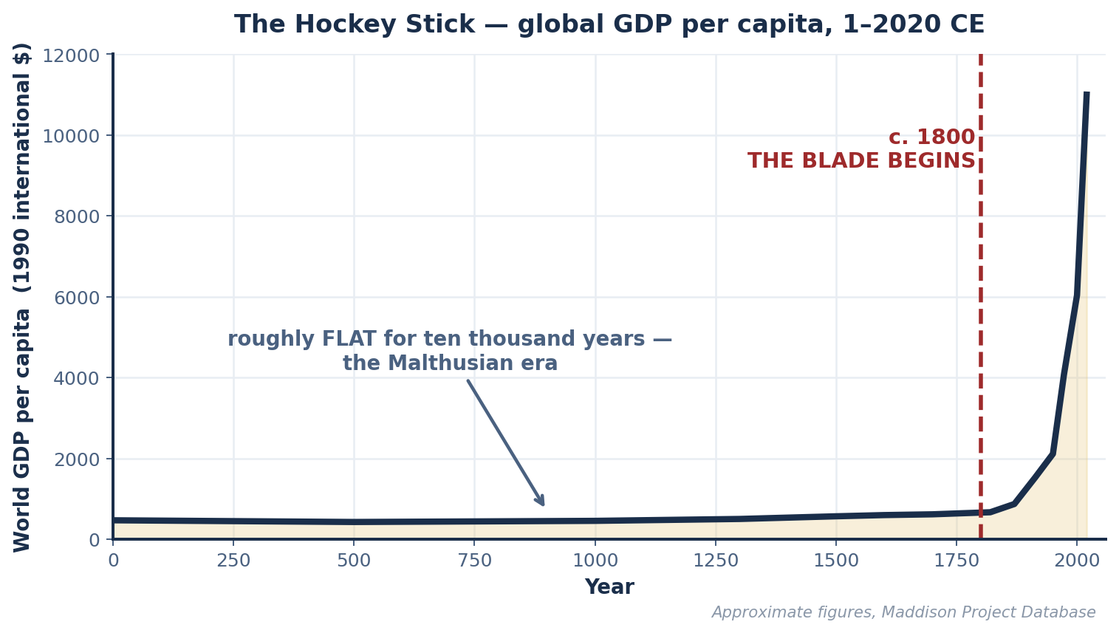
PART 3 · THE CENTRAL FACT
The Hockey Stick
THE SHAPE
Global GDP per capita was roughly FLAT for ten thousand years, then rose exponentially from about 1800.
The handle is the Malthusian era: real gains in output were absorbed by population. The blade is the escape: sustained growth in output PER PERSON.
WHY 1800?
Because that is when technological change became CONTINUOUS and CUMULATIVE rather than episodic — and when the capital stock began to deepen fast enough to keep raising labor's marginal product.
A CAUTION ABOUT AVERAGES
This is a WORLD AVERAGE. It conceals as much as it reveals: whose incomes rose, when, and at whose expense. Part 4 disaggregates it, and the disaggregation is the more important picture.
INTRO TO MICROECONOMICS | PROF. VELAZQUEZ
MODULE 6: MARKETS, HISTORY & THE GLOBAL ECONOMY

Slide 14
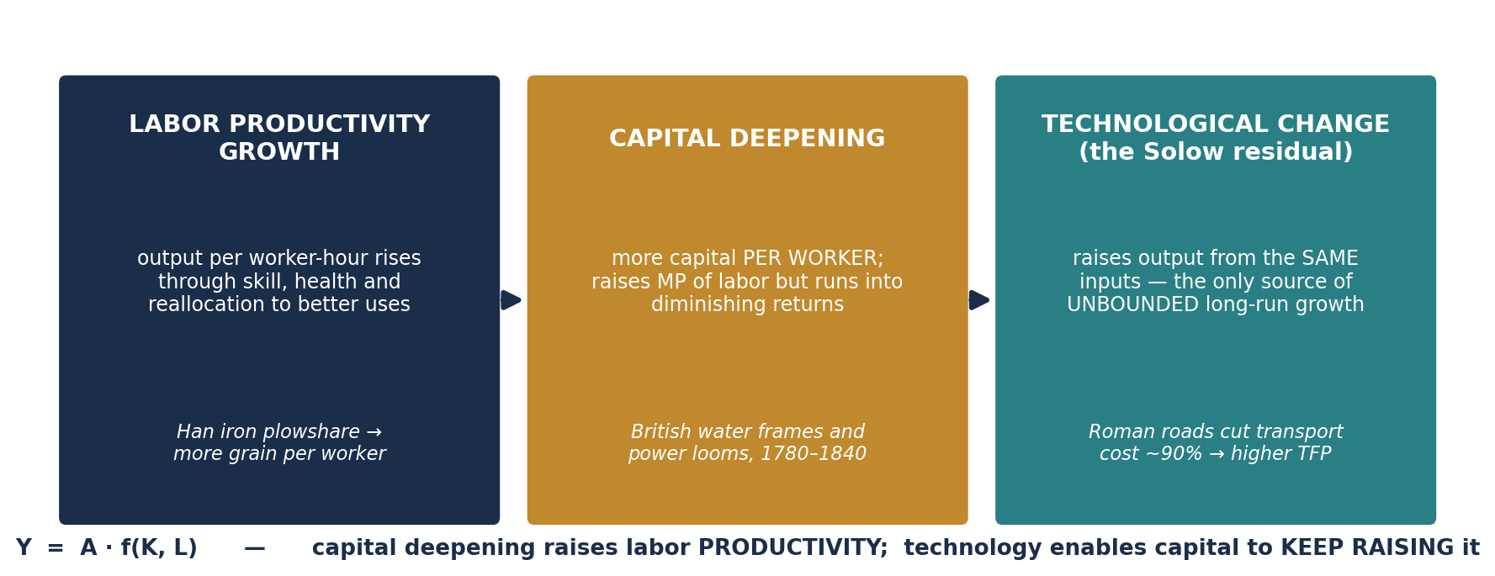
PART 3 · THE MECHANISM
Three Engines of Long-Run Growth
Y = A · f ( K, L )
Y = A · K^α · L^(1−α)
THE SOLOW RESIDUAL — why it matters
Capital deepening drives growth until DIMINISHING RETURNS set in — each additional machine adds less than the last (you proved this in Module 5's ripple sequence). Only a rise in A produces UNBOUNDED long-run growth.
Rome's roads raised A. Han iron plowshares raised A. Institutions that protect research and enable diffusion raise A. This is why Part 4's institutional argument is a GROWTH argument, not merely a fairness one.
THE SOLOW GROWTH MODEL. A = Total Factor Productivity — the part of output growth that capital and labor
alone CANNOT explain. Think of A as the EFFECTIVENESS of labor.
INTRO TO MICROECONOMICS | PROF. VELAZQUEZ
MODULE 6: MARKETS, HISTORY & THE GLOBAL ECONOMY

Slide 15
PART 3 · READING HISTORY WITH THE TOOLKIT
Which Module Explains Which Era?
PERIOD | HOW HUMANS ORGANIZED SCARCE RESOURCES, LABOR, PRODUCTION, EXCHANGE AND POWER | OUR TOOLKIT SAYS…
300,000–10,000 BCE Hunter-gatherer | Immediate-return foraging; sharing norms; no storable surplus; no property in land. | M1 scarcity and opportunity cost; M2 constrained choice. No market model — there is no price.
10,000–3,500 BCE Agricultural Revolution | Sedentism, domestication, storable grain surplus, the first fixed claims on land. | M1 PPM and the shift outward; M5 land as a factor with newly-defined property rights.
3,500–500 BCE Early states & cities | Temple and palace redistribution; standardized weights; the first written accounts (Ur, Anyang). | M1 budget constraints (our Ur and Anyang scenarios); M5 extractive institutions capturing surplus.
500 BCE–500 CE Classical & interregional | Long-distance trade, coinage, road networks, slavery as a labor institution. | M1 comparative advantage (Egypt & Rome); M3 markets and prices; M5 factor markets under coercion.
500–1500 CE Agrarian-commercial | Silk Road, Indian Ocean and trans-Saharan networks; credit instruments; guilds. | M3 supply, demand and equilibrium (Sogdian silk, Kilwa ivory, Basra wheat); M4 elasticity (Banda nutmeg).
1500–1750 CE Early modern globalization | Atlantic system, chartered companies, silver flows, plantation slavery, mercantilist policy. | M4 market power and collusion (Fiji copra); M5 factor extraction. The toolkit begins to strain here.
1750–1900 CE INDUSTRIALIZATION — the blade | Steam, factories, capital deepening, wage labor, colonial de-industrialization. | M5 VMP and capital deepening (Britain & Bengal); M6 the three engines; M6 Part 4 the Great Divergence.
1900–1970s Mass industrial & consumer society | Assembly lines, mass consumption, unions, welfare states, two world wars. | M4 welfare economics and policy; M5 labor markets (WWI female entry, the Great Migration).
1970s–2000s Globalized information economy | Containerization, offshoring, financialization, deregulation. | M4 elasticity and incidence; M5 loanable funds (2004–08); M10–11 market structure.
2000s–present Digital & AI era | Network effects, platform monopolies, intangible capital, algorithmic allocation. | M11 imperfect competition; M7 knowledge diffusion and AI bias; M12 policy. Largely BEYOND the competitive model.
INTRO TO MICROECONOMICS | PROF. VELAZQUEZ
MODULE 6: MARKETS, HISTORY & THE GLOBAL ECONOMY

Slide 16
SCENARIO 6.2 · ENGLAND, 1780–1840, AND WORKSHEET ✦3
The British Industrial Revolution — and Who the Hockey Stick Missed
TECHNOLOGY (steam) → CAPITAL DEEPENING (factories) → LABOR PRODUCTIVITY DOUBLES AND REDOUBLES → REAL WAGES RISE
The causal chain runs left to right, and each arrow is one of the three engines activating the next. Note the LAG: British real wages did not rise durably until after roughly 1840–50 — a full two generations behind the productivity gain. That gap is itself a distributional fact.
1
BRITAIN — the engine fires
2
BENGAL — the same shock, reversed
3
✦3 TWO MORE GROUPS THE STICK MISSED
Steam power (technology) enabled large-scale capital accumulation (factories). Capital per worker rose sharply, raising the MARGINAL PRODUCT of British labor and therefore its VMP.
Labor demand shifted right; in the long run real wages rose. This is Module 5's Step 1–4 sequence, playing out over sixty years.
The identical technological shock rendered the marginal product of Indian artisan weavers effectively obsolete. British cloth, made cheaply and admitted freely, displaced handloom output.
VMP fell; labor demand fell; earnings collapsed. One innovation, two opposite VMP paths — and the mechanism is the SAME equation.
ENSLAVED PEOPLE IN THE ATLANTIC SYSTEM: their labor raised output enormously while their compensation was zero by law. VMP rose; the wage did not, because there was no labor MARKET — an institutional, not a technological, fact.
EARLY FACTORY WORKERS AND CHILDREN, 1780–1840: productivity rose for two generations before real wages followed. Capital deepening raised A; the GAINS accrued to the owners of the deepened capital until institutions — factory acts, unions, franchise extension — changed who could claim them.
THE ANALYTICAL POINT
In all four cases — Britain, Bengal, the plantation, the early mill — the three-engine framework correctly predicts the movement of PRODUCTIVITY. It does not, on its own, predict who receives the resulting income. That requires knowing the institutions: who may enter the market, who may organize, who owns the capital, and whose property is protected. Growth and distribution are separate questions, and the toolkit answers only the first.
INTRO TO MICROECONOMICS | PROF. VELAZQUEZ
MODULE 6: MARKETS, HISTORY & THE GLOBAL ECONOMY

Slide 17
04
The Great Divergence
PART
OBJECTIVE Analyze the Great Divergence; evaluate competing explanations — institutions, geography, colonial extraction and technological accident.
INTRO TO MICROECONOMICS | PROF. VELAZQUEZ
MODULE 6: MARKETS, HISTORY & THE GLOBAL ECONOMY

Slide 18
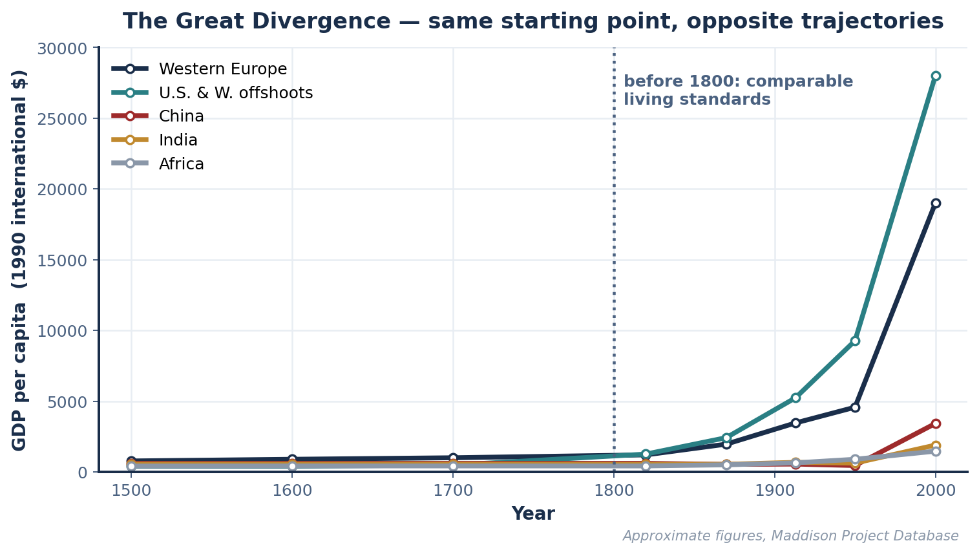
PART 4 · THE FACT TO BE EXPLAINED
Before 1800, Comparable. By 1900, Not.
BRITAIN — industrialized
Accumulated industrial capital; VMP of workers rising; real wages begin rising after 1850. EXPLAINED BY: M5 capital deepening and VMP; M6 three engines. NOT EXPLAINED: why competitors were not permitted to respond in kind.
CHINA — coerced openness
Handicraft sector trapped in a low-wage equilibrium; silver drained via unequal treaties; capital accumulation blocked. NOT EXPLAINED: treaty ports and indemnities were imposed by force. No price in any model reflects a gunboat.
INDIA / BENGAL — de-industrialized
Handloom weavers displaced; the economy pushed back toward agriculture; income stagnant or falling. NOT EXPLAINED: asymmetric tariffs and administered terms of trade are POLICY, not technology.
SUB-SAHARAN AFRICA — extracted
THE CORE FACT
Comparable living standards in 1750 — a five- to tenfold gap by 1900.
Land and labor extracted under colonial arrangements; capital accumulation blocked. NOT EXPLAINED: coerced labor and expropriated land sit outside any voluntary-exchange framework.
INTRO TO MICROECONOMICS | PROF. VELAZQUEZ
MODULE 6: MARKETS, HISTORY & THE GLOBAL ECONOMY

Slide 19
PART 4 · FOUR COMPETING HYPOTHESES
Explaining the Great Divergence
HYPOTHESIS | CORE CLAIM | KEY EVIDENCE FOR | KEY COUNTEREVIDENCE
INSTITUTIONAL QUALITY Acemoglu & Robinson (2012) Nobel 2024 | Inclusive institutions — secure property rights, broad political participation, open entry — generate investment and innovation. Extractive institutions concentrate surplus in an elite and kill the incentive to invest. | Dell (2010): districts just inside Peru's colonial mit'a boundary have consumption 25% lower TODAY — a regression discontinuity at a 500-year-old line. Also the Korea / North Korea comparison: identical geography and culture, opposite institutions, opposite outcomes. | Institutions are partly ENDOGENOUS — prosperity may cause good institutions as much as the reverse. And 18th-century Britain was hardly inclusive by any modern standard: a tiny franchise, extensive slavery in its empire.
GEOGRAPHIC DETERMINISM Diamond (1997) | Resource endowments, disease environment and agricultural potential set the starting conditions. Domesticable species, navigable rivers, temperate climates and coal deposits determine who could industrialize. | The east-west axis of Eurasia genuinely did allow crops and animals to diffuse across similar latitudes. Tropical disease burden is a real and measurable drag on labor productivity. | Geography is FIXED, yet the ranking of regions has reversed repeatedly — China led the world in 1000 CE with the same geography it had in 1900. Fixed causes cannot explain changing outcomes.
COLONIAL EXTRACTION | European powers extracted surplus from colonies — silver, cotton, sugar, labor — and that surplus funded European industrialization while blocking accumulation elsewhere. | The scale is documented: Bengal's revenue transfers after 1757; Atlantic slavery's profits; the Chinese indemnities. De-industrialization of Indian textiles is directly traceable to asymmetric tariff policy. | The TIMING is contested: Britain's takeoff sectors were domestically financed, and some highly extractive colonial powers (Spain, Portugal) industrialized LATE and slowly. Extraction may be a consequence of power as much as a cause of growth.
TECHNOLOGICAL ACCIDENT (the 'coal and colonies' thesis) | Britain happened to have accessible coal near water transport, a high-wage economy that made labor-saving machinery profitable, and a specific run of inventions. Industrialization was contingent, not destined. | Allen (2009): British wages were unusually HIGH and energy unusually CHEAP, so mechanization paid there and nowhere else. The same machines were unprofitable in low-wage India. | It explains WHERE the first takeoff occurred, but not why the gap PERSISTED and widened for two centuries after the technology became universally known.
✦4 HOW WOULD YOU TEST YOUR PREFERRED HYPOTHESIS?
The strongest designs exploit sharp boundaries and near-identical comparison cases: Dell's mit'a discontinuity; the Korean partition; settler-mortality instruments; within-country variation in colonial administration. The question to ask of any claim is: what is the COUNTERFACTUAL, and does a case exist that isolates it?
INTRO TO MICROECONOMICS | PROF. VELAZQUEZ
MODULE 6: MARKETS, HISTORY & THE GLOBAL ECONOMY

Slide 20
05
Poverty Measurement
& the Kuznets Curve
PART
OBJECTIVE Distinguish absolute from relative poverty; define the poverty trap; evaluate the Kuznets Curve hypothesis and its policy prescription.
INTRO TO MICROECONOMICS | PROF. VELAZQUEZ
MODULE 6: MARKETS, HISTORY & THE GLOBAL ECONOMY

Slide 21
PART 5 · DEFINITIONS AND THEIR CONSEQUENCES
Measuring Poverty
CONCEPT | DEFINITION | POLICY IMPLICATION
ABSOLUTE POVERTY | Income or consumption below a FIXED threshold defined by the cost of meeting basic physical needs — food, shelter, water, minimum health. The World Bank's international line is $2.15 per day at 2017 PPP. | Target GROWTH and direct transfers sufficient to lift households over a fixed line. Success is measurable, and by this measure the last forty years show enormous progress.
RELATIVE POVERTY | Income below a threshold defined RELATIVE TO THE SOCIETY'S OWN DISTRIBUTION — commonly below 50% or 60% of median income. It is a measure of exclusion from ordinary social participation. | Target the DISTRIBUTION, not only the level: minimum wages, progressive tax and transfer, public provision. Growth alone can leave relative poverty untouched or worsen it.
POVERTY TRAP | A self-reinforcing mechanism by which being poor makes it harder to stop being poor: no collateral so no credit (M2, M5); the bandwidth tax of scarcity (M2); poor health lowering productivity; thin local labor markets (M5 monopsony). | One-off transfers may not suffice — the household returns to the trap. Policy must be large enough or sustained enough to push past the threshold. This is the case for asset transfers and 'big push' programs.
KUZNETS CURVE (1955) | The hypothesis that inequality first RISES and then FALLS as income per capita grows — an inverted U. | The famous prescription: 'GROW FIRST, REDISTRIBUTE LATER.' Rising inequality is read as a temporary and self-correcting phase of development.
WHY THE ABSOLUTE / RELATIVE DISTINCTION IS NOT MERELY TECHNICAL
The two measures can move in OPPOSITE directions at the same time, and frequently do. A country can halve absolute poverty over two decades while relative poverty rises — because the median rose faster than the bottom. Which number a government reports is therefore a political choice as much as a statistical one, and Module 1's positive / normative distinction applies with full force: the MEASUREMENT is positive, the CHOICE OF MEASURE is normative.
INTRO TO MICROECONOMICS | PROF. VELAZQUEZ
MODULE 6: MARKETS, HISTORY & THE GLOBAL ECONOMY

Slide 22
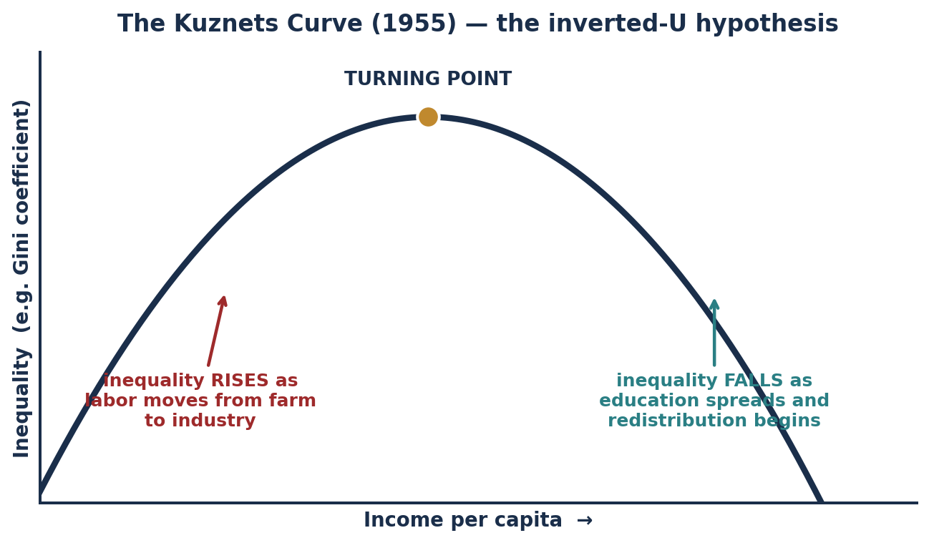
PART 5 · THE HYPOTHESIS AND ITS CRITICS
The Kuznets Curve & Worksheet ✦5
THE MECHANISM KUZNETS PROPOSED
Inequality RISES first because labor moves from a low-productivity, low-dispersion agricultural sector into a high-productivity industrial sector. Early movers gain; those left behind do not. Inequality is measured ACROSS the two sectors, so it widens mechanically as the transition proceeds.
It FALLS later as the transition completes, education spreads, and political pressure produces redistribution.
THE EMPIRICAL VERDICT
WEAK, and largely NEGATIVE for the late 20th century. Inequality ROSE sharply in most advanced economies from roughly 1980 onward — precisely the segment of the curve where Kuznets predicts it should fall.
Piketty (2013) argues the mid-century compression Kuznets observed was not a developmental regularity at all, but the specific product of two world wars, the Depression, and the postwar tax and institutional settlement. When r > g, the underlying tendency is toward CONCENTRATION, not convergence.
✦5 CRITIQUING 'GROW FIRST, REDISTRIBUTE LATER'
THE RISK: it treats rising inequality as self-correcting and therefore as requiring no action — but inequality is PATH-DEPENDENT. Concentrated wealth buys political influence that entrenches the rules producing it; unequal childhoods produce unequal human capital a generation later; the 'later' may never arrive. ALTERNATIVE PATHS TRIED: East Asian land reform BEFORE industrialization (Korea, Taiwan) delivered rapid growth WITH low inequality; Nordic universal provision alongside open markets; conditional cash transfers (Brazil, Mexico) redistributing DURING growth. The evidence does not support a necessary trade-off between the two.
INTRO TO MICROECONOMICS | PROF. VELAZQUEZ
MODULE 6: MARKETS, HISTORY & THE GLOBAL ECONOMY

Slide 23
06
Climate Arc Part 1:
Market Failure & Externalities
PART
OBJECTIVE Introduce the climate arc: negative externalities, the divergence of private and social cost, and why the market's own surplus calculation overstates welfare.
INTRO TO MICROECONOMICS | PROF. VELAZQUEZ
MODULE 6: MARKETS, HISTORY & THE GLOBAL ECONOMY

Slide 24
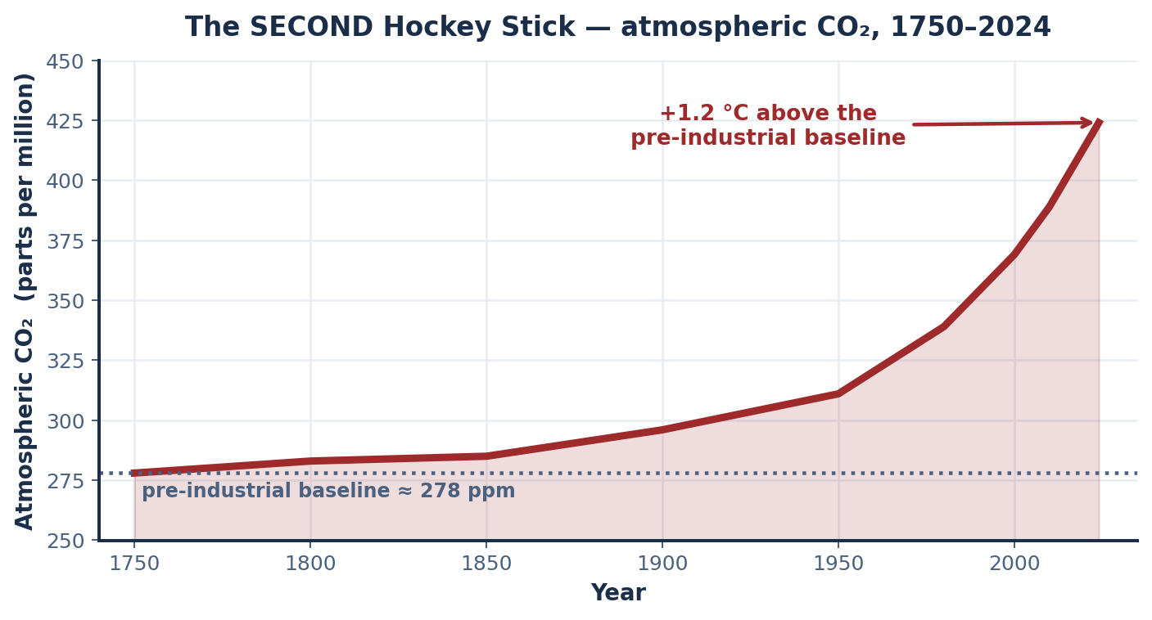
PART 6 · THE SECOND HOCKEY STICK
The Same Revolution Produced Both Curves
OPENING DATA
Global average CO₂ concentration: ~280 ppm in 1750 → ~420 ppm today.
Global average temperature: +1.2 °C above the pre-industrial baseline.
Projected economic damages from 2 °C warming: 2–4% of world GDP per year — CONCENTRATED IN THE LOWEST-INCOME COUNTRIES.
THE UNCOMFORTABLE SYMMETRY
The engine that produced the income hockey stick — the continuous, cumulative combustion of fossil energy to deepen capital and raise A — is the same engine that produced the CO₂ hockey stick.
They are not two stories. They are one story, measured on two axes.
THE ANALYTICAL QUESTION
Our market model recorded every coal transaction and pronounced each one efficient. Consumer surplus was positive; producer surplus was positive; the market cleared.
So where, precisely, in the Module 3–4 apparatus, did the damage go? The answer is that it went WHERE THE MODEL DOES NOT LOOK.
INTRO TO MICROECONOMICS | PROF. VELAZQUEZ
MODULE 6: MARKETS, HISTORY & THE GLOBAL ECONOMY

Slide 25
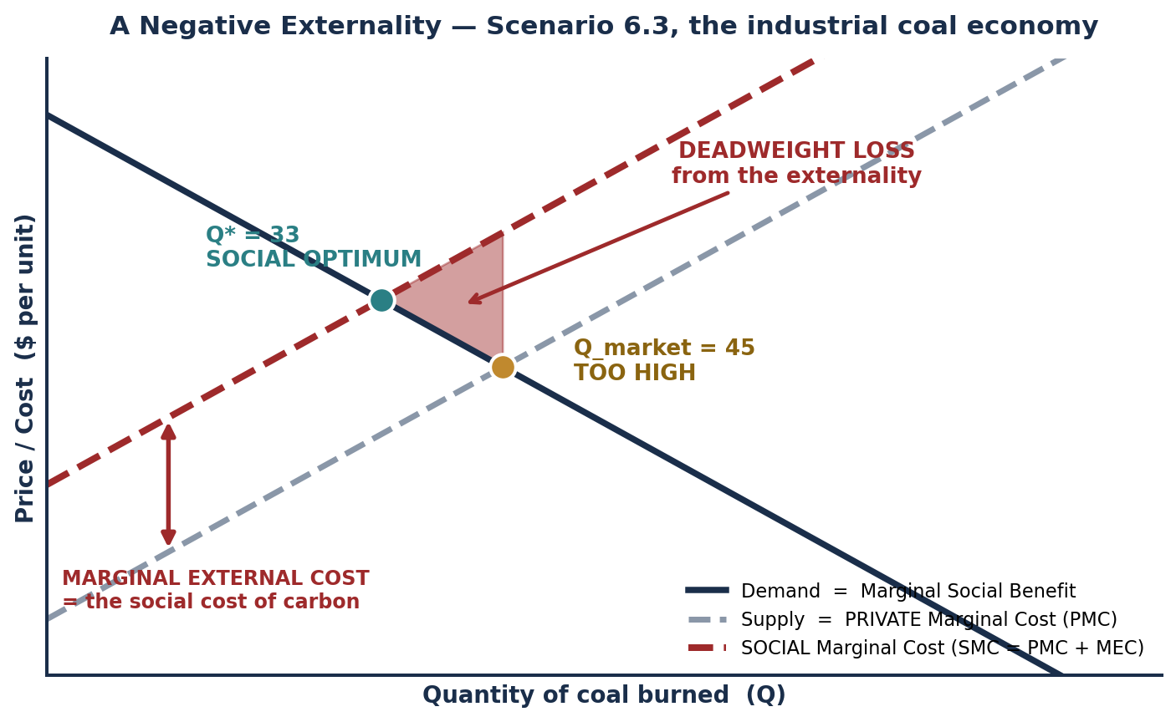
PART 6 · THE FORMAL APPARATUS
Private Cost, Social Cost & the Externality
TERM | DEFINITION
PRIVATE COST | The cost borne by the PRODUCER of the good — extraction, labor, transport, capital. This is what the supply curve measures.
PRIVATE BENEFIT | The benefit received by the BUYER of the good — heat, light, motion, output. This is what the demand curve measures.
PRIVATE EQUILIBRIUM | Where private marginal cost equals private marginal benefit: the market outcome, Q_market. Every model in Modules 3–5 has computed exactly this point.
EXTERNALITY | A cost or benefit of a transaction that falls on a THIRD PARTY who is neither the buyer nor the seller, and which is therefore not reflected in the price.
SOCIAL COST | SOCIAL COST = PRIVATE COST + MARGINAL EXTERNAL COST. For fossil fuel: the extraction cost PLUS the climate damage imposed on everyone else, now and in the future.
SOCIAL BENEFIT | Private benefit plus any benefit accruing to third parties. For a negative externality this equals private benefit — the demand curve is unchanged.
SOCIAL OPTIMUM | Where SOCIAL marginal cost equals social marginal benefit: Q*. Because SMC lies ABOVE PMC, Q* is LESS than Q_market. The market produces TOO MUCH.
MARKET FAILURE | Any situation in which a competitive market, left alone, fails to allocate resources efficiently. An uncorrected negative externality is the canonical case.
SOCIAL COST = PRIVATE COST + MARGINAL EXTERNAL COST
Q_market > Q*. The deadweight loss is the triangle between them, valued at the marginal external cost — the SOCIAL COST OF CARBON.
INTRO TO MICROECONOMICS | PROF. VELAZQUEZ
MODULE 6: MARKETS, HISTORY & THE GLOBAL ECONOMY

Slide 26
SCENARIO 6.3 · BRITAIN 1850–1950 & GLOBAL 1950–PRESENT
The Atmosphere as a Commons
CONCEPT | HOW IT APPLIES TO CLIMATE CHANGE | WHICH MODULE ADDRESSES THIS
NEGATIVE EXTERNALITY | Burning fossil fuels imposes a cost — climate damage — on people who are NOT party to the transaction between the fuel buyer and the fuel seller. | M6 Part 6 (here); formalized with Pigouvian taxes and cap-and-trade in M12.
TOTAL SURPLUS IS OVERSTATED | The CS + PS from burning fuel is positive — but this ignores the climate damage borne by billions who are not in the market. True social welfare is far LOWER than the market records. | M4 Part 4 — consumer and producer surplus, and the three assumptions the invisible hand theorem requires.
TRAGEDY OF THE COMMONS | The atmosphere is a COMMON RESOURCE — rival in use but non-excludable, and owned by no one. Each emitter has an incentive to use it freely even though collective overuse destroys it. | M11 game theory — this is a many-player prisoner's dilemma; M12 types of goods and Ostrom's institutional alternatives.
THE PRICE SIGNAL IS MISSING | Fossil fuels are priced on EXTRACTION cost, not on climate damage cost. Without a price on carbon, the market sends NO SIGNAL to reduce emissions — the coordination mechanism of Module 3 simply has nothing to transmit. | M3 the price mechanism; M4 tax incidence — a carbon price is a tax, and its incidence follows the elasticity rule exactly.
DISTRIBUTIONAL INJUSTICE | Countries with the LOWEST per-capita CO₂ emissions — many low-income nations — bear the GREATEST climate damages: rising seas, drought, crop failure. | M6 Part 4 the Great Divergence; M7 structural inequality — this is Climate Arc Part 2.
✦6 WHY CO₂ IS HARDER THAN A NORMAL EXTERNALITY
Carbon dioxide is a STOCK pollutant — it accumulates over centuries, so today's emission damages people not yet born. That temporal dimension breaks the standard static model in three ways. (1) DISCOUNT RATES: comparing costs today with damages in 2150 requires choosing a discount rate, and the choice — not the physics — dominates the answer (this is the Stern–Nordhaus dispute). (2) INTERGENERATIONAL EQUITY: future people cannot bid in today's market, so their willingness to pay is structurally absent from demand. (3) IRREVERSIBILITY AND TIPPING POINTS: the damage function may be non-linear and non-recoverable, which invalidates marginal analysis precisely where it matters most.
INTRO TO MICROECONOMICS | PROF. VELAZQUEZ
MODULE 6: MARKETS, HISTORY & THE GLOBAL ECONOMY

Slide 27
MODULE 6 · WHERE WE GO NEXT
The Climate Arc and the Second Half of the Course
1
CLIMATE ARC PART 1 — HERE
2
CLIMATE ARC PART 2 — MODULE 7
3
CLIMATE ARC PART 3 — MODULE 12
MODULE 6: we establish the MECHANISM. A negative externality drives a wedge between private and social cost; the market overproduces; total surplus as we measured it in Module 4 systematically overstates welfare.
The tool: the externality diagram you just drew.
MODULE 7: we analyze the DISTRIBUTIONAL INJUSTICE. Who emitted, who bears the damage, and why those are largely different populations — connected directly to the Great Divergence you analyzed in Part 4.
MODULE 12: we evaluate the POLICY RESPONSE. Pigouvian taxes, cap-and-trade, the Coase theorem, direct regulation, and the political economy of each — using the tax incidence machinery from Module 4.
MODULE | WHAT IT REMOVES FROM THE COMPETITIVE MODEL
7 — Structural Inequality | The assumption that the initial distribution of endowments is given and irrelevant to the analysis.
8 — Who Gets What and Why | The assumption that factor markets are competitive and information is symmetric.
9–10 — Firms, Cost & Profit Maximization | The assumption that firms are a black box; we open it and derive supply from cost.
11 — Imperfect Competition & Game Theory | The assumption of price-taking. Firms become strategic actors.
12 — Policy, Paradox & Human Perspectives | The assumptions of no externalities, complete information, and consistent rational preferences — all three at once.
THE THROUGH-LINE
Every remaining module removes one assumption you have been quietly relying on since Module 1. The toolkit does not get discarded — it gets HONEST.
INTRO TO MICROECONOMICS | PROF. VELAZQUEZ
MODULE 6: MARKETS, HISTORY & THE GLOBAL ECONOMY

Slide 28
YOU TRY
Module 6 — Independent Practice
Complete all six Parts of the Module 6 Worksheet — including the synthesis map in Part 1 and the period table in Part 3, which are the most demanding items in the packet.
Write your own draft of the course thesis in Part 1. You will revise it at the end of Modules 8 and 12; keep all three drafts.
Draw the externality diagram by hand: PMC, SMC, demand, Q_market, Q*, and the deadweight loss triangle, all labeled.
Answer reflection questions ✦1 through ✦6 in complete sentences. These are argument questions, not calculation questions — expect to write a paragraph each.
This module is the bridge into Midterm 2. If any tool in the Part 1 synthesis map is unclear to you, office hours NOW, not in November.
25
MIN
INTRO TO MICROECONOMICS | PROF. VELAZQUEZ

Slide 29
MODULE 6
What You Should Be Able to Do
 | LEARNING OUTCOME
Part 1 | For each of the six core tools from Modules 1–5, state the module, the core question it answers, and its key limitation; articulate a defensible draft of the course thesis; identify and defend the single assumption you find most consequential.
Part 2 | State Malthus's two inputs and the constraint; explain why individually rational fertility decisions produce a collectively subsistence outcome; distinguish the technological escape from the demographic transition; identify the conditions under which the trap still binds; state Sen's entitlement critique.
Part 3 | Name and define the three engines of growth; write the Solow production function and explain what A represents; explain why capital deepening alone cannot generate unbounded growth; describe the hockey stick and name at least two groups for whom it was delayed, suppressed or reversed.
Part 4 | State the Great Divergence fact with approximate magnitudes; summarize all four explanatory hypotheses with their strongest evidence and strongest counterevidence; propose an empirical design that would discriminate between two of them.
Part 5 | Distinguish absolute from relative poverty and state the policy implication of each; define a poverty trap and name three mechanisms that sustain one; state the Kuznets hypothesis, its proposed mechanism, and the late-20th-century evidence against it; critique 'grow first, redistribute later'.
Part 6 | Define negative externality, private cost, social cost and marginal external cost; draw and label the externality diagram including Q_market, Q* and the DWL triangle; explain why market-recorded total surplus overstates welfare; explain three ways a stock pollutant complicates the static model.
NEXT
MODULE 7 — WHO GETS WHAT AND WHY. We stop asking how big the pie is and start asking who gets a slice, and why. Structural inequality, information problems, and the distributional analysis this module has been pointing toward all semester.
INTRO TO MICROECONOMICS | PROF. VELAZQUEZ
MODULE 6: MARKETS, HISTORY & THE GLOBAL ECONOMY

Slide 30
MODULE 6
References
Acemoglu, D., & Robinson, J. A. (2012). Why nations fail: The origins of power, prosperity, and poverty. Crown.
Allen, R. C. (2009). The British Industrial Revolution in global perspective. Cambridge University Press.
Bolt, J., & van Zanden, J. L. (2020). Maddison Project Database, version 2020. University of Groningen.
CORE Economics Education. (2023). The Economy 2.0: Macroeconomics, Unit 1.
Dell, M. (2010). The persistent effects of Peru's mining mita. Econometrica, 78(6), 1863–1903.
Diamond, J. (1997). Guns, germs, and steel: The fates of human societies. W. W. Norton.
Kuznets, S. (1955). Economic growth and income inequality. American Economic Review, 45(1), 1–28.
Malthus, T. R. (1798). An essay on the principle of population. London: J. Johnson.
North, D. C. (1990). Institutions, institutional change, and economic performance. Cambridge University Press.
Piketty, T. (2014). Capital in the twenty-first century. Harvard University Press.
Pomeranz, K. (2000). The great divergence: China, Europe, and the making of the modern world economy. Princeton University Press.
Sen, A. (1981). Poverty and famines: An essay on entitlement and deprivation. Oxford University Press.
Solow, R. M. (1957). Technical change and the aggregate production function. Review of Economics and Statistics, 39(3), 312–320.
INTRO TO MICROECONOMICS | PROF. VELAZQUEZ
MODULE 6: MARKETS, HISTORY & THE GLOBAL ECONOMY

